Slide 1

Job Grids
22PMC113
Animesh Thomas

Slide 2
ABSTRACT
The Online Employee Recruitment System is a mini project aimed at simplifying and streamlining the process of employee recruitment for organizations. The system provides a user-friendly interface for both providers and job seekers, facilitating efficient and effective recruitment processes.

Slide 3
PROJECT REQUIREMENTS
User Registration and Login For both Job Seekers and Job Providers(Companies).
Feature to Add New Job Openings For Companies.
Feature to Approve New Company Registrations into the System by Verifying Uploaded Documents.
Feature for Applying the jobs.
Feature for Companies to View Job Applications.
Ability to View the resume of the applied candidates.
Ability to Select/Reject Candidates.
Feature For Adding Reviews About the System

Slide 4
FEATURES AND HIGHLIGHTS OF THE PROJECT
1.Resume Submission:
Job seekers can submit their personal and academic information online through the system. This feature eliminates the need for physical paper work and simplifies the application process for candidates.
2. Efficiency and Time-saving:
By automating various recruitment processes, the system saves time and reduces manual efforts. Job providers can manage applications, shortlist candidates, and schedule interviews more efficiently, ultimately accelerating the overall recruitment timeline.
3. User-friendly Interface:
The system provides a user-friendly interface for both job providers and job seekers. It is designed to be intuitive and easy to navigate, ensuring a positive user experience for all stakeholders.

Slide 5
4. Feedback system:
A feedback system allows both job seekers and job providers to provide feedback on their experience throughout the recruitment process.
5. Advanced Search :
Enhanced search functionality by adding more advanced filters such as location, salary range, experience level, and specific keyword.
6.Notifications and Communication:
Notification system to keep job seekers and companies/recruiters informed about the status of their applications, new job postings, and important updates.
7.Admin Panel:
Empowered admins with verification of job provider registrations and access to valuable system insights such as users count, job applications, and top-performing providers and seekers.

Slide 6
TECHNICAL ASPECTS
Backend Framework:
Django is a popular choice for building web applications, and it can be used as the primary backend framework for the project.
Frontend Technologies:
The frontend can be developed using HTML, CSS, and JavaScript.
Database:
A relational database management system (RDBMS) such as SQLLite can be used to store and manage applicant data, job postings, and other relevant information.
Authentication and Security:
Django provides built-in authentication and authorization mechanisms, which can be leveraged to handle user registration, login, and access control.

Slide 7
Third-Party Libraries:
Bootstrap:
Bootstrap is a popular CSS framework used for responsive web design and UI components, making it easier to create visually appealing and mobile-friendly interfaces.
Pillow:
A powerful library for image processing and manipulation.
Admin Volt:
By using the "adminvolt" package, developers can potentially add additional features, modify the layout and design, or enhance the user interface of the Django admin panel. It might provide templates, widgets, or other components that allow for easier customization and styling of the admin interface.

Slide 8
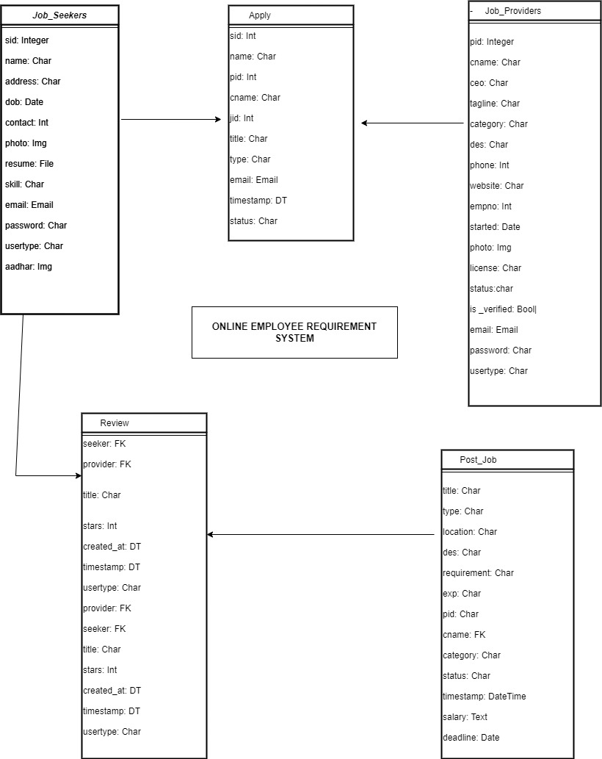
CLASS DIAGRAM:

Slide 9
THE ARCHITECTURE
Models:
The models define the data structures and relationships within the LMS, including entities such as Users, Courses, Enrollments, Content, Assessments, and Grades.
View Models:
View models handle the business logic data flow between the models and templates. They handle user requests, retrieve data from the database, and prepare the data for rendering in the templates.
Templates:
Templates contain the HTML/CSS structure and presentation logic for rendering the user interface. They are responsible for displaying the data fetched from the views and rendering it in a user-friendly format.
Routers:
Routers handle the URL routing and map the incoming requests to the appropriate views or view models. They define the endpoints and HTTP methods for handling user requests

Slide 10
THE ARCHITECTURE
Model:
In the MVC architectural pattern, the Model represents the data and business logic of your application. It defines the structure and behavior of the database tables and handles data manipulation, validation, and querying. In this project, the Model component would handle entities such as job postings, user profiles, and reviews.
View:
The View component is responsible for rendering the user interface and presenting data to the user. It interacts with the Model to retrieve the required data and pass it to the templates for rendering. In this project, the View component would handle actions such as displaying job listings, user profiles, and search results.
Controller:
The Controller component, in Django's case, is handled by the framework itself. It processes incoming requests, routes them to the appropriate View, and handles the logic for authentication, URL routing, and data retrieval. It acts as the intermediary between the user interface and the data layer.

Slide 11
CHALLENGES FACED
Designing a User-Friendly Interface:
Integrating multiple templates into a cohesive and consistent user interface. Creating an intuitive and user-friendly interface that caters to both providers and job seekers is a very challenging tasks. Balancing the need for comprehensive functionality with simplicity and ease of use requires careful design and user testing.
2. Style Clashes:
Challenge: Dealing with conflicting CSS styles when combining templates from different sources.
Solution: Identify conflicting styles by inspecting the elements using browser developer tools. Use CSS methodologies like BEM (Block, Element, Modifier) or utility classes to encapsulate styles and minimize clashes. Prioritize styles based on specificity and override conflicting styles as needed
3. Deadline Management:
To address this challenge, I leveraged the built-in date.today() function in Django to accurately track and manage job deadlines. By utilizing this function, the system ensured that job postings remained up-to-date and relevant.

Slide 12
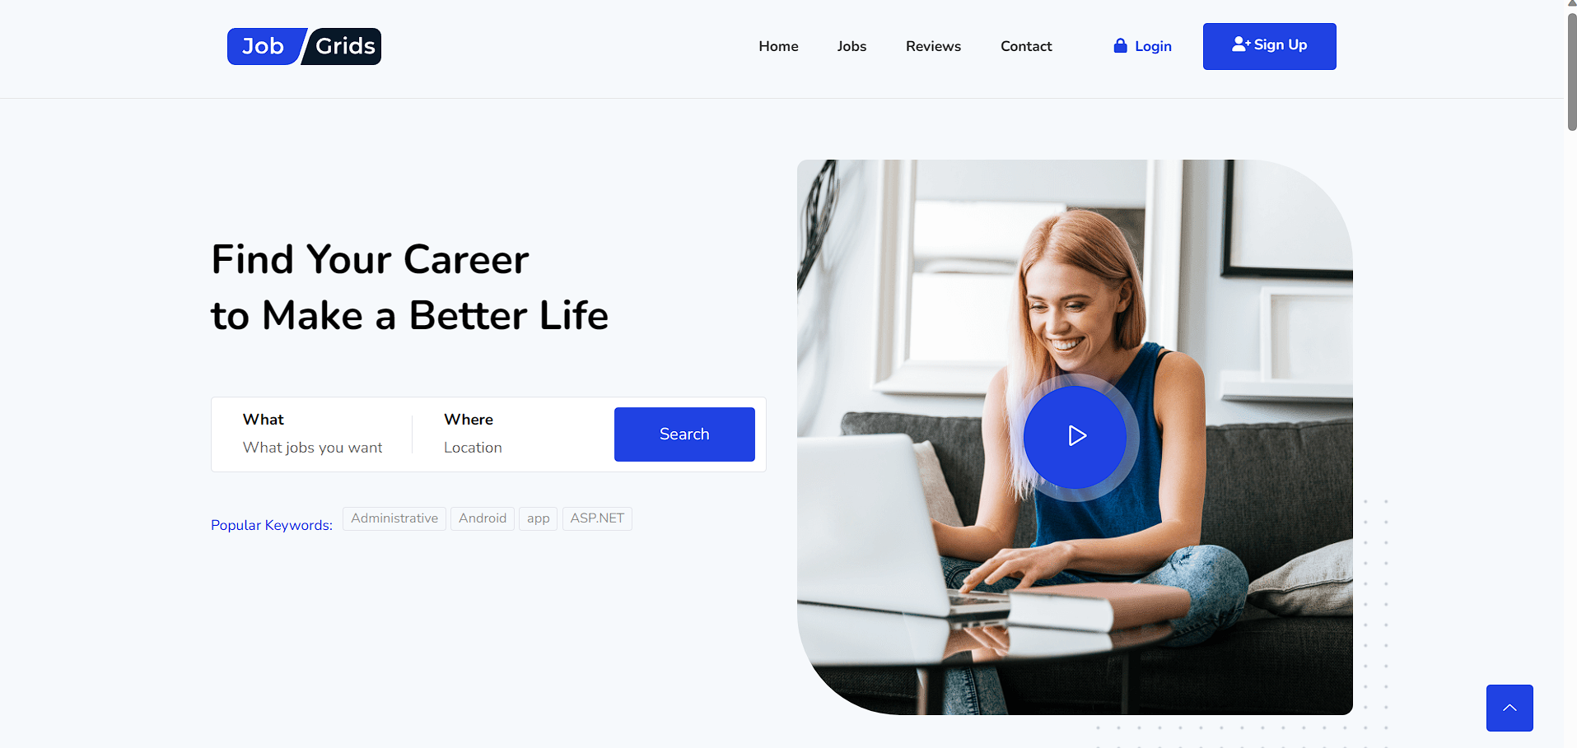
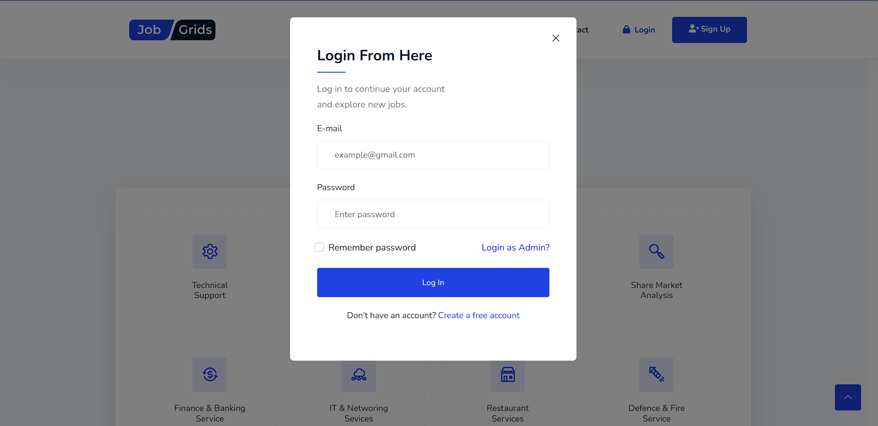
HOME PAGE
LOGIN

Slide 13
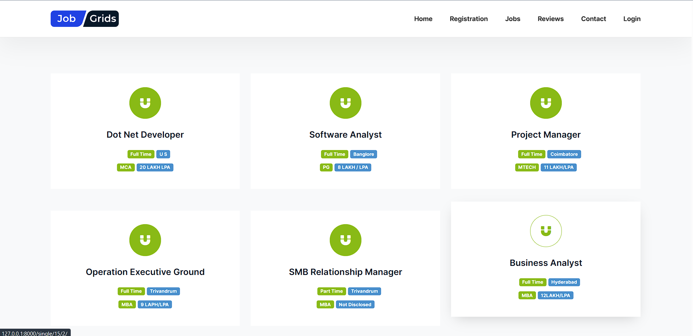
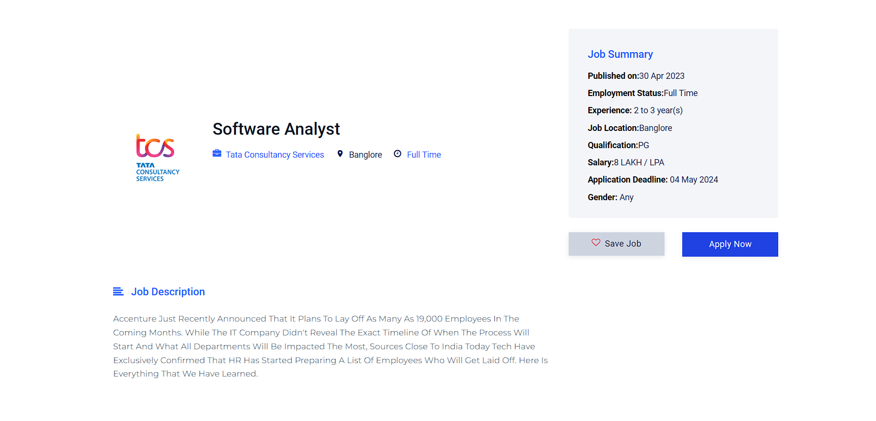
ALL JOBS SECTION

Slide 14
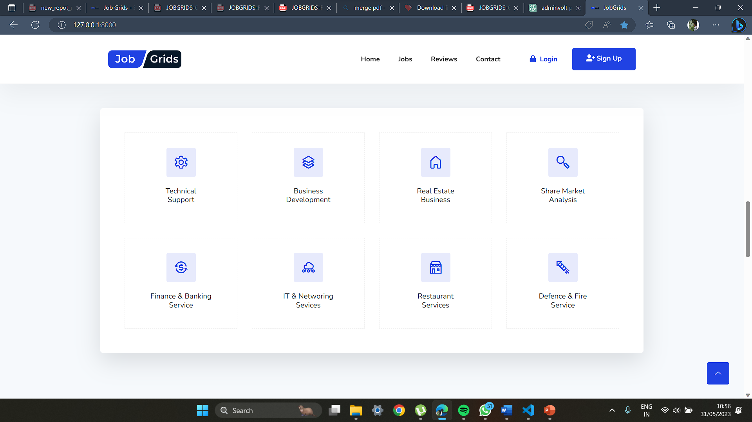
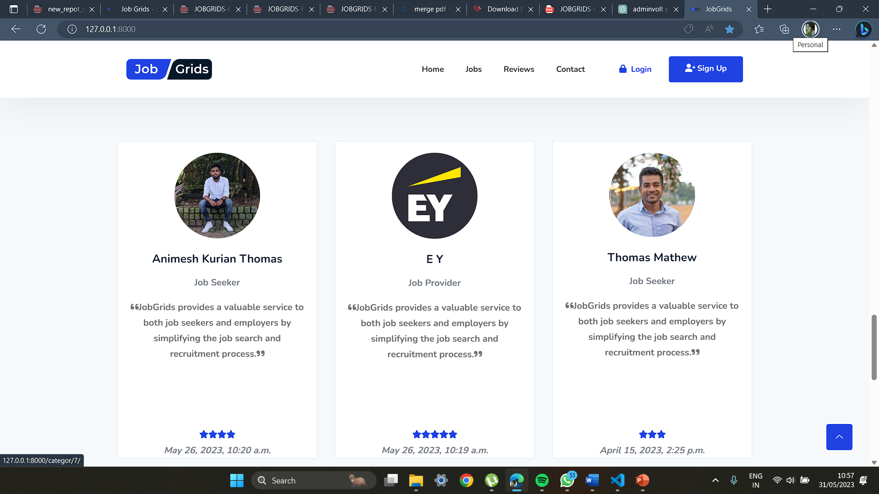
CATEGORY FILTERING
TESTIMONIALS

Slide 15
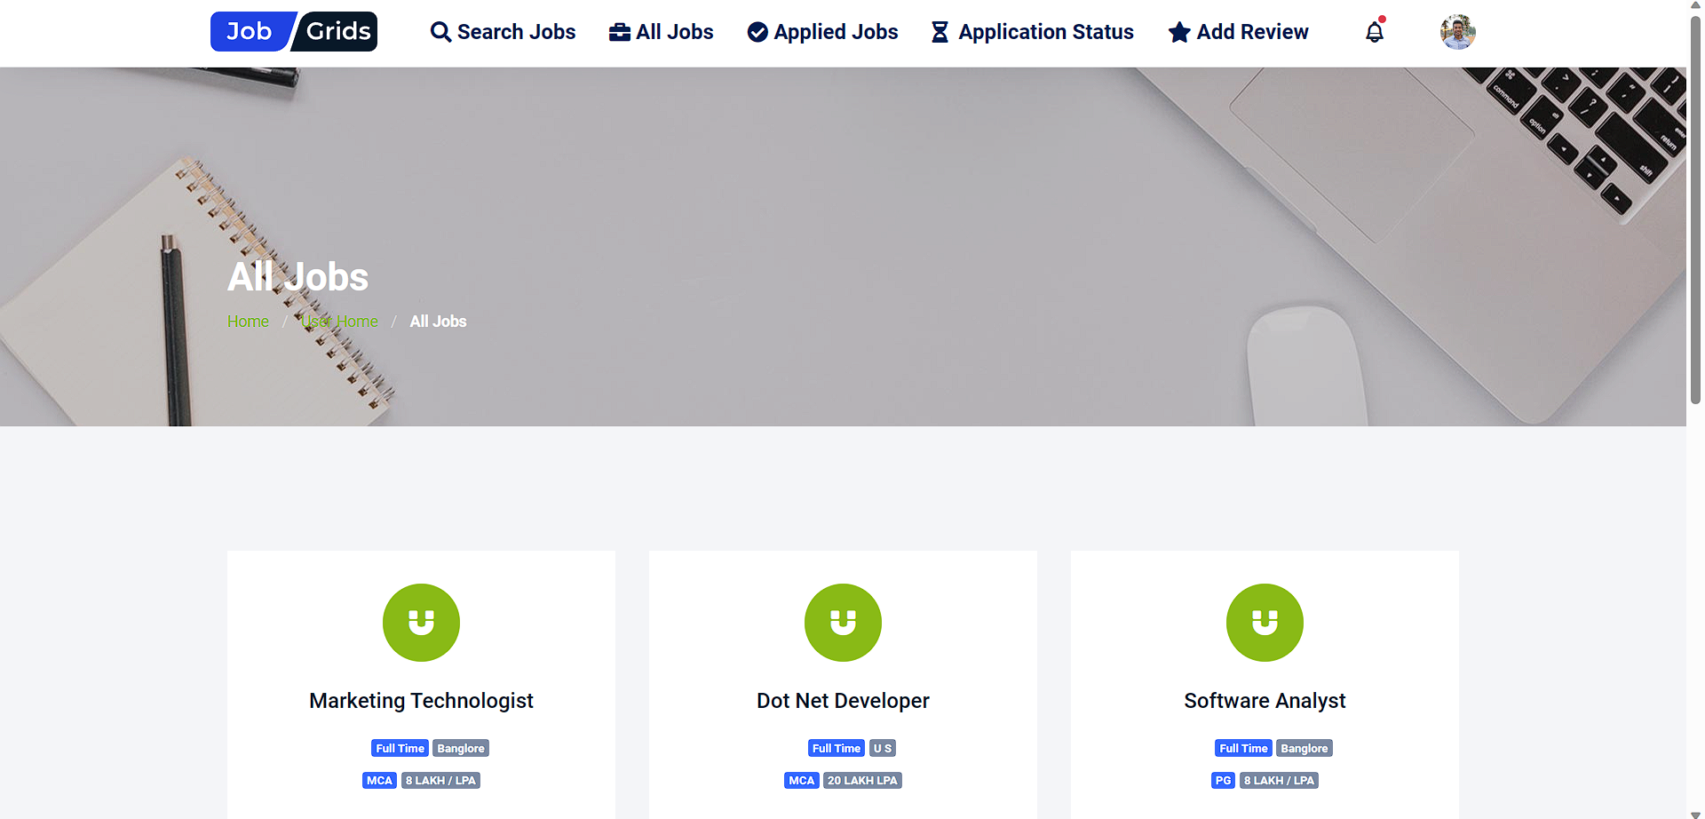
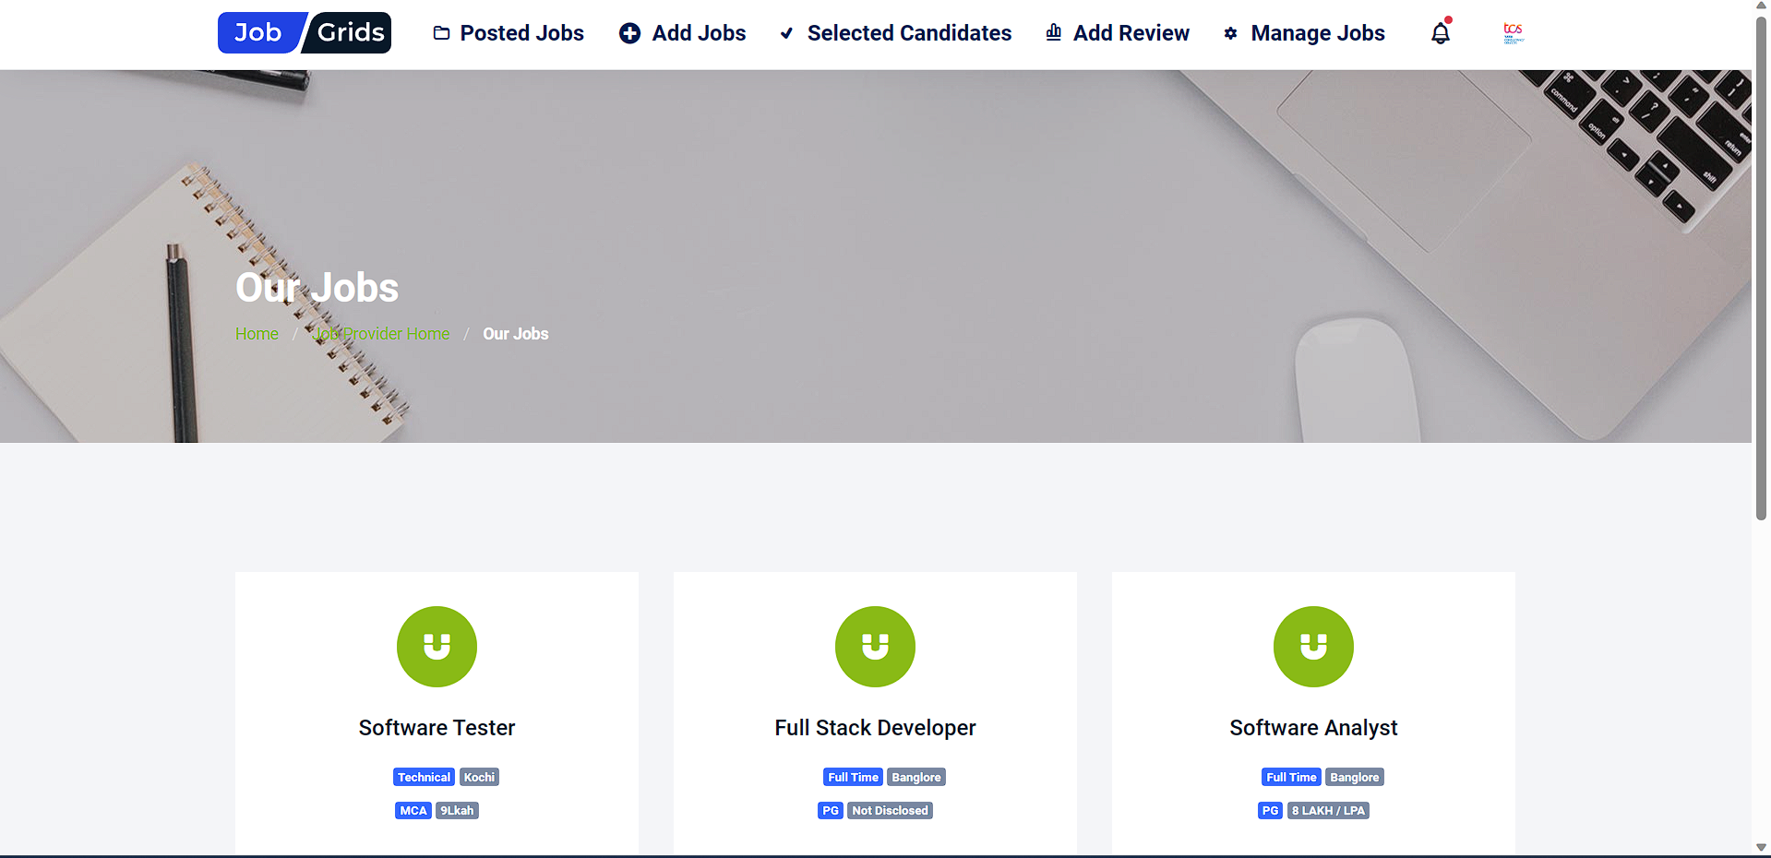
JOB SEEKER’S HOME PAGE
JOB PROVIDER HOME PAGE

Slide 16
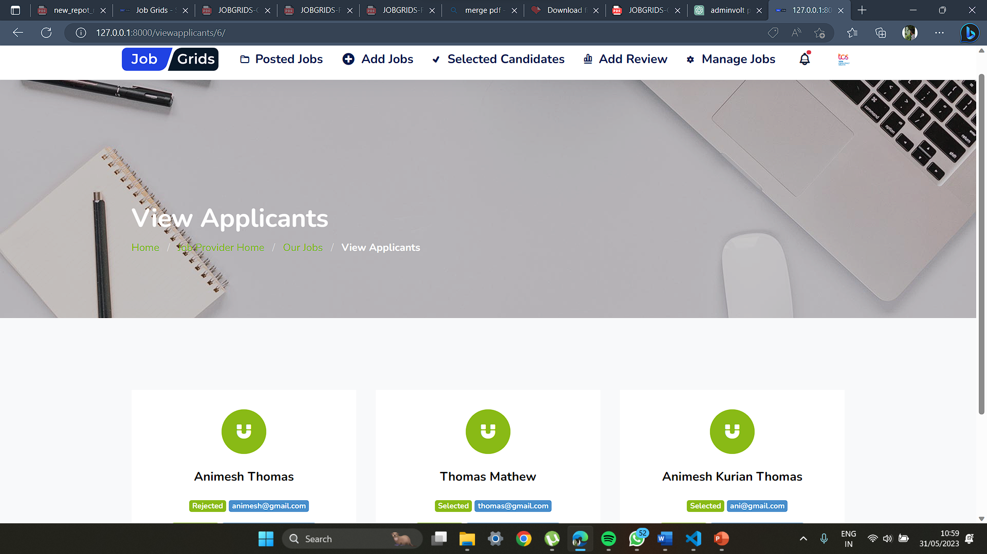
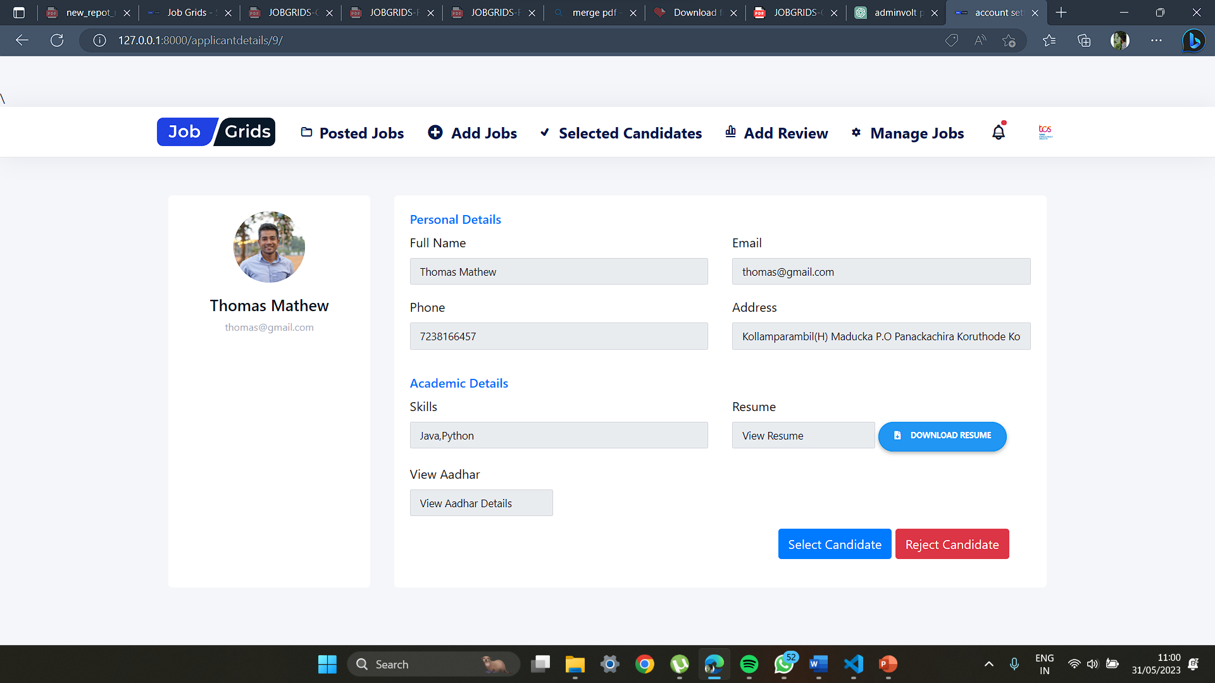
VIEW APPLICANTS
APPLICANT DETAILS

Slide 17
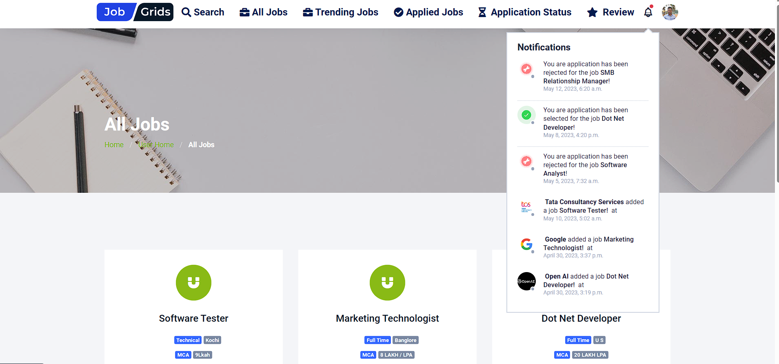
APPLICATION STATUS

Slide 18
FUTURE ENHANCEMENTS
1.Video Interviews and Assessments:
Integrate video interviewing capabilities, allowing candidates to record or participate in live video interviews directly within the system.
2. Integration with Social Media:
Enable job seekers to share job postings on social media platforms to expand their reach.
3. Advanced Job Matching Algorithm:
Develop a sophisticated matching algorithm that analyzes job seeker profiles and job requirements to provide more accurate and personalized job recommendations.
4. Machine Learning for Resume Parsing:
Utilize machine learning techniques to extract relevant information from uploaded resumes and automatically populate job seeker profiles, saving time and improving data accuracy.

Slide 19
In conclusion, the development of an online employee recruitment system in Django and Python can significantly streamline the hiring process for both job seekers and job providers/recruiters. By implementing various features and enhancements, the system can provide a user-friendly and efficient platform for application management, candidate selection, and communication.
The implemented features allow job seekers to search for relevant job opportunities based on their requirements, apply for jobs seamlessly, and receive updates on their application status. Employers can easily manage job applications, review candidate resumes, select or reject candidates. The addition of a review system enables users to provide feedback and share their experiences, contributing to the continuous improvement of the recruitment process.
Overall, the online employee recruitment system in Django and Python provides a comprehensive solution that simplifies the recruitment process, enhances user experience, and helps organizations find the right talent efficiently.

Slide 20


REFERENCES
https://www.linkedin.com/jobs/?originalSubdomain=in
https://www.naukri.com/registration/createAccount?othersrcp=22636
https://preview.graygrids.com/item/jobgrids-job-board-and-job-portal-web-template/
https://github.com/animeshthomas/Job-Grids

Slide 21

Thanks!
Please keep this slide for attribution

